Slide 1
Guide to Networking Essentials,
6th Edition
Chapter 5: Network Protocols

Slide 2
Objectives
Describe the purpose of a network protocol, the layers in the TCP/IP architecture, and the protocols in each TCP/IP layer
Explain IP address configuration and subnetting
Copyright © 2012 Cengage Learning. All rights reserved.

Slide 3
TCP/IP’s Layered Architecture
Protocols are rules and procedures for communication and behavior
  Computers must “speak” the same language and agree on the rules of communication
When a set of protocols works cooperatively it is called a protocol stack or protocol suite
The most common protocol stack is Transmission Control Protocol/Internet Protocol (TCP/IP)
TCP/IP is composed of more than a dozen protocols operating at different levels of the communication process
Copyright © 2012 Cengage Learning. All rights reserved.

Slide 4
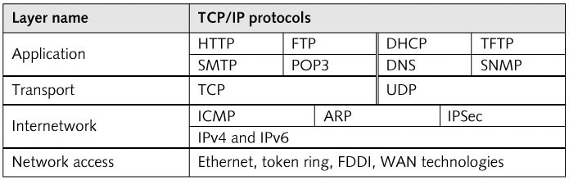
TCP/IP’s Layered Architecture
TCP/IP Layered Architecture
Copyright © 2012 Cengage Learning. All rights reserved.

Slide 5

TCP/IP’s Layered Architecture
Example of how the layers work together:
  You start your Web browser and your home page is http://www.course.com
  The web browser formats a request for your home page by using the Application layer protocol HTTP
  The request looks something like:
  The unit of information the Application layer works with is simply called “data”
Copyright © 2012 Cengage Learning. All rights reserved.

Slide 6
TCP/IP’s Layered Architecture
Example continued:
  The Application-layer protocol HTTP passes the request down to the Transport-layer protocol (TCP)
  TCP adds a header to the request that looks like:
  The unit of information the Transport layer works with is called a segment
  TCP passes the segment to the Internetwork layer protocol (IP)
  IP places its header on the segment:
  The unit of information is now called a packet
Copyright © 2012 Cengage Learning. All rights reserved.

Slide 7
TCP/IP’s Layered Architecture
Example continued:
  The packet is passed down to the Network access layer, where the NIC operates
  A frame header and trailer are added
  The frame is then delivered to the network medium as bits on its way to the www.course.com server
  The web server processes it and returns a Web page to the computer that originated the request
Copyright © 2012 Cengage Learning. All rights reserved.

Slide 8
Role of the Network Access Layer
Provides a physical (MAC) address for the network interface
Verifies that incoming frames have the correct destination MAC address
Defines and follows media access rules
Receives packets from the Internetwork layer and encapsulates them to create frames
De-encapsulates received frames and sends the resulting packets to the Internetwork layer
Copyright © 2012 Cengage Learning. All rights reserved.

Slide 9
Role of the Network Access Layer
Provides frame error detection in the form of a CRC code
Transmits and receives bit signals
Defines the signaling needed to transmit bits, whether electrical, light pulses, or radio waves
Defines the media and connectors needed to make a physical network connection
Copyright © 2012 Cengage Learning. All rights reserved.

Slide 10
Role of the Internetwork Layer
The Internetwork layer is where administrators usually do the most network configuration
This is where the IP protocol operates and is the heart of the TCP/IP protocol suite
Responsible for four main tasks:
  Defines and verifies IP addresses
  Routes packets through an internetwork
  Resolves MAC addresses from IP addresses
  Delivers packets efficiently
Copyright © 2012 Cengage Learning. All rights reserved.

Slide 11
Defines and Verifies IP Addresses
An IP address is assigned to every computer and network device using TCP/IP for communications
IP addresses are used for two main purposes
  To identify a network device at the Internetwork layer
  To identify the network on which a device resides
When a device receives an IP packet, it compares the destination IP address with its own
  If it matches or is a broadcast, the packet is processed
  It is does not match then it is discarded
Copyright © 2012 Cengage Learning. All rights reserved.

Slide 12
Routes Packets Through an Internetwork
The Internetwork layer determines the best way to get a packet from network to network until it reaches its destination
Most large internetworks, such as the Internet, have multiple paths for getting from one network to another
Routers work at the Internetwork layer and it is their job to select the best path to the destination
  Routers use the network identifier portion of IP addresses along with their routing tables to determine the best path
Copyright © 2012 Cengage Learning. All rights reserved.

Slide 13
Resolves MAC Addresses from IP Addresses
Every frame contains source and destination physical MAC and logical IP addresses
When a packet is ready to be sent to the Network access layer, the destination device’s MAC address must be retrieved before the frame header can be constructed
TCP/IP uses Address Resolution Protocol (ARP) to find MAC addresses
  ARP is discussed in more detail later in the chapter
Copyright © 2012 Cengage Learning. All rights reserved.

Slide 14
Delivers Packets Efficiently
Internetwork-layer protocols are primarily focused on efficient delivery of packets
  Internetwork-layer protocols don’t include features such as flow control, delivery confirmation, or message assembly
  These features require overhead to ensure reliable delivery
  Rely on the protocols in the Transport and Application layers to provide these reliability features
  Considered a connectionless protocol – relies on upper-layer protocols to ensure the packet’s safe journey
Copyright © 2012 Cengage Learning. All rights reserved.

Slide 15
Protocols at the Internetwork Layer
Internet Protocol version 4
  More commonly known as “IP”
  Most common version in networks and the first version that was in widespread use
  Defines a 32-bit dotted decimal IP address
    Example: 172.31.149.10
    172.31 = network id and 149.10 = host id (actual device on the network)
  Important fields in an IP packet:
    Version = version of IP in use
    Time to live (TTL) = prevents a packet from wandering aimlessly through an internetwork
    Protocol = numeric code specifying the type of IP packet
    Checksum = value that protects the IP header’s contents
    Source and Destination address
Copyright © 2012 Cengage Learning. All rights reserved.

Slide 16
Protocols at the Internetwork Layer
Internet Protocol version 6 (IPv6)
  Has many of the features of IPv4
  Uses a different format for IP addresses
  Can run alongside IPv4 without needing to change the Transport Layer or Network Access Layer
Address Resolution Protocol
  Used to resolve a logical (IP) address to physical (MAC) address
  When a source doesn’t have the destination’s MAC, it sends out an ARP broadcast frame requesting the MAC address corresponding to the host’s IP address
  A network configured with the specified IP address responds with an ARP reply containing its MAC address
Copyright © 2012 Cengage Learning. All rights reserved.

Slide 17
Protocols at the Internetwork Layer
Address Resolution Protocol (cont.)
  To avoid sending an ARP request every time an IP packet is sent, PCs and other devices store learned IP address/MAC address pairs in an ARP cache, which is a temporary location in RAM
  If the destination computer is on another network, the computer uses ARP to retrieve the MAC address of the router configured as its default gateway
    The packet is delivered to the router and the router determines where the packet should go next to get to its destination
    When the packet gets to the destination network, the router on the destination network uses ARP to get the destination computer’s MAC address
Simulation 9 – The changing frame header
Copyright © 2012 Cengage Learning. All rights reserved.

Slide 18
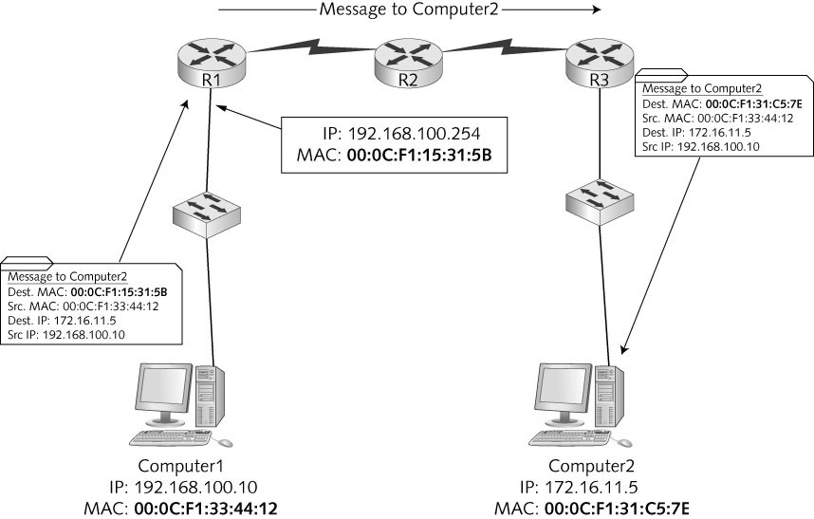
Protocols at the Internetwork Layer
Copyright © 2012 Cengage Learning. All rights reserved.

Slide 19
Protocols at the Internetwork Layer
Internet Control Message Protocol (ICMP)
  Used to send error and control messages between systems or devices
  Specialized IP packet with its own header
  Ping program uses ICMP Echo packets to request a response from another computer or to verify whether it is available for communication
  An ICMP Reply indicates whether the host is reachable and how long the message’s round trip from sender to receiver took
Copyright © 2012 Cengage Learning. All rights reserved.

Slide 20
Protocols at the Internetwork Layer
Internet Protocol Security (IPSec)
  Works with IPv4 to ensure secure delivery of packets
  IPSec can be used to secure sensitive network transmissions between computers needing extra security
  Provides security by using authentication and encryption
  Requires additional network and computer resources so it should be enabled only for highly sensitive communication and in environments where security risks are high
Copyright © 2012 Cengage Learning. All rights reserved.

Slide 21
Role of the Transport Layer
Transport layer provides reliability needed to handle the unpredictable nature of the Internet
Two protocols:
  Transmission Control Protocol (TCP):
    Connection-oriented and designed for reliable transfer of information in complex internetworks
  User Datagram Protocol (UDP):
    Connectionless and designed for efficient communication of generally small amounts of data
  Both:
    Work with segments
    Provide a means to identify the source and destination applications involved in a communication
    Protect data in the segment with a checksum
Copyright © 2012 Cengage Learning. All rights reserved.

Slide 22
Working with Segments
Both Transport-layer protocols work with units of data called segments
Both TCP and UDP add a header to data
The Transport-layer protocol then passes the segment to the Internetwork protocol (IP)
With incoming data, the Transport-layer receives the segment from the Internetwork protocol, processes it, de-encapsulates it and sends the resulting data up to the Application layer
Copyright © 2012 Cengage Learning. All rights reserved.

Slide 23
Identifying Source and Destination Applications
How do computers keep track of incoming data when a Web browser, email application, chat and a word processing program are all running at the same time?
TCP and UDP use port numbers to specify the source and destination Application-layer protocols
  Port numbers are 16-bit values assigned to specific applications running on a computer or network device
Copyright © 2012 Cengage Learning. All rights reserved.

Slide 24
Protecting Data with a Checksum
To protect data integrity, TCP and UDP provide a checksum similar to the CRC in the Network access layer
Intermediate devices don’t recalculate the checksum in the Transport layer so if data corruption occurs during the transmission, the final receiving station detects the checksum error and discards the data
Copyright © 2012 Cengage Learning. All rights reserved.

Slide 25
TCP: The Reliable Transport Layer
If an application requires reliable data transfer, it uses TCP as the Transport-layer protocol
TCP provides reliability by using these features:
  Establishing a connection
  Segmenting large chunks of data
  Ensuring flow control with acknowledgments
TCP is a connection-oriented protocol
  It establishes a connection with the destination, data is transferred, and the connection is broken
Copyright © 2012 Cengage Learning. All rights reserved.

Slide 26
Establishing a Connection: The TCP Handshake
A client sends a TCP synchronization (SYN) segment to the destination device, usually a server
  A destination port is specified and a source port is assigned dynamically
When the server receives the SYN segment, it usually responds by sending either an acknowledgment-synchronization (ACK-SYN) segment or a reset connection (RST) segment
  RST is sent when the server refuses the request to open the session
  If an ACK-SYN is returned, the client completes the three-way handshake by sending an ACK segment back to the server
Copyright © 2012 Cengage Learning. All rights reserved.

Slide 27
Segmenting Data
When TCP receives data from the Application layer, the size might be too large to send in one piece
TCP breaks the data into smaller segments (max frame sent by Ethernet is 1518 bytes)
Each segment is labeled with a sequence number so that if segments arrive out of order they can be reassembled in the correct order
Copyright © 2012 Cengage Learning. All rights reserved.

Slide 28
Flow Control with Acknowledgments
Flow control prevents a destination from becoming overwhelmed by data, resulting in dropped packets
TCP establishes a maximum number of bytes, called the window size, that can be sent before the destination must acknowledge the receipt of data
If no acknowledgment is received within a specified period of time, the sending station will retransmit from the point at which an acknowledgment was last received
Copyright © 2012 Cengage Learning. All rights reserved.

Slide 29
Role of the Application Layer
The Application layer provides network services to user applications that access network resources
With most Application layer protocols, both a client and a server version exist
The Application layer provides these functions:
  Access by applications to network services
  Client/server data access
  Name resolution
  Dynamic address assignment
  Authentication/user logon
  Data formatting and translation
Copyright © 2012 Cengage Learning. All rights reserved.

Slide 30
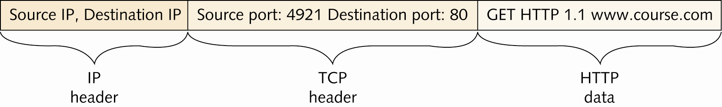
HTTP:Protocol of the World Wide Web
Originally, its main purpose was to transfer static web pages written in HTML
Now, it is also used for general file transfer and downloading/displaying multimedia files
Uses TCP as its Transport-layer protocol
Default TCP port number is 80
Copyright © 2012 Cengage Learning. All rights reserved.

Slide 31
POP3, IMAP, and SMTP: E-mail Protocols
Post Office Protocol version 3 (POP3) is used to download incoming messages from e-mail servers to local desktops (uses TCP port 110)
Internet Message Access Protocol (IMAP) is used to manage email messages locally, yet stores them on a server (uses TCP port 143)
Simple Mail Transfer Protocol (SMTP) is the standard protocol for sending email over the Internet (uses TCP port 25)
Copyright © 2012 Cengage Learning. All rights reserved.

Slide 32
Dynamic Host Configuration Protocol
A drawback of using TCP/IP in a large network is keeping track of assigned addresses and to which machine they are assigned
DHCP is used to automatically assign IP addresses as needed
  When a computer is turned on, it requests an address from a server that is configured as a DHCP server
  The server assigned an address for a specific amount of time (called a lease)
  If the computer is still on and the lease is 87.5% expired, a broadcast DHCP renewal request is sent
Uses UDP Transport layer because DHCP messages are short in length
Copyright © 2012 Cengage Learning. All rights reserved.

Slide 33
Domain Name System
DNS is a name-to-address resolution protocol that keeps a list of computer names and their IP addresses
With a DNS, a user can use a computer’s name instead of its IP address
Example:
  When you enter www.course.com in your Web browser, the browser contacts the DNS server specified in your OS’s IP configuration and requests that the url be resolved to an IP address
  Once the IP address for the website is returned, your computer can contact Web server to request a Web page
DNS uses UDP because DNS messages usually consist of a single packet of data
Copyright © 2012 Cengage Learning. All rights reserved.

Slide 34
Domain Name System
DNS is organized as a treelike hierarchy
Organized into domain levels
  Top-level domains are organized into categories such as commercial (.com), nonprofit organizations (.org), government (.gov) or country of origin indicated by a two-letter code
  Second-level domains are usually the name of a company or institution
  Subdomain is optional and can consist of names separated by a period
  Host level represents individual computers hosting network services
Example: www.books.tomsho.com
  com is the top-level domain name, tomsho is the second-level domain, books is the subdomain, and www is the hostname
Copyright © 2012 Cengage Learning. All rights reserved.

Slide 35
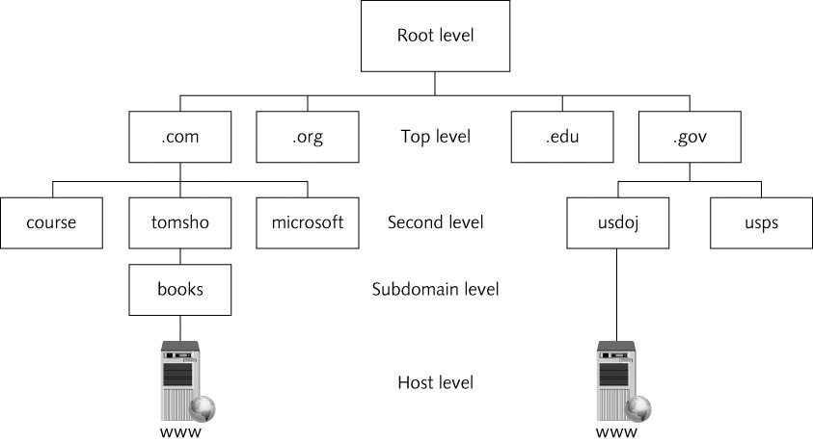
Domain Name System
Copyright © 2012 Cengage Learning. All rights reserved.

Slide 36
IP Addressing
IP is responsible for addressing and routing in the TCP/IP environment
An IP address is 32-bits in length
  Grouped into four 8-bit octets and each octet is represented by a decimal number from 0-255
  Four decimal numbers are separated by periods in a format called dotted decimal notation
  Example: 172.24.208.192
  Divided into two parts: network ID and host ID
  In the above address, host ID 208.192 resides on network 172.24
Copyright © 2012 Cengage Learning. All rights reserved.

Slide 37
IP Address Classes
IP addresses are categorized in Classes A-E
  Only IP addresses in the A, B, and C classes are available for host assignment
Class A
  Value of the first octet is between 1 and 127
  Addresses beginning with 127 are reserved for loopback
  IP registry assigns the first octet, leaving the last three octets to be assigned to hosts
  Intended for large corporations and government
Class B
  Value of the first octet is between 128 and 191
  IP registry assigns the first two octets, leaving the third and fourth octets to be assigned to hosts
  Intended for use in medium to large networks
Copyright © 2012 Cengage Learning. All rights reserved.

Slide 38
IP Address Classes
Class C
  Value of the first octet is between 192 and 223
  IP address registry assigns the first three octets
  These networks are limited to 254 hosts per network
  Intended for small networks
Class D
  Value of the first octet is between 224 and 239
  Reserved for multicasting
Class E
  Value of the first octet is between 240 and 255
  Reserved for experimental use and can’t be used for address assignment
Copyright © 2012 Cengage Learning. All rights reserved.

Slide 39
Private IP Addresses
Due to the popularity of TCP/IP and the Internet, we are running out of unique IP addresses
A series of addresses have been reserved for private networks (networks whose hosts can’t be accessed directly through the Internet)
Reserved addresses:
  Class A addresses beginning with 10
  Class B addresses from 172.16 to 172.31
  Class C addresses from 192.168.0 to 192.168.255
The addresses in those ranges can’t be routed across the Internet
Copyright © 2012 Cengage Learning. All rights reserved.

Slide 40
Network Address Translation
NAT allows an organization to use private IP addresses while connected to the Internet
The NAT process translates a workstation’s private address (as a packet leaves the corporate network) into a valid public Internet address
  When data returns to the workstation, the address is translated back to the original private address
  NAT is usually handled by a network device connected to the Internet, such as a router
  Address translation is kept track of in a NAT table
Copyright © 2012 Cengage Learning. All rights reserved.

Slide 41
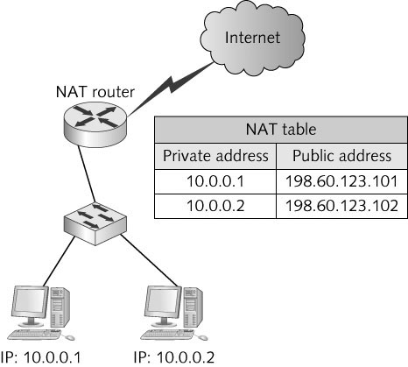
Network Address Translation
Copyright © 2012 Cengage Learning. All rights reserved.

Slide 42
Network Address Translation
Port Address Translation (PAT)
  Allows several hundred workstations to access the Internet with a single public Internet address
  Each packet contains source and destination IP addresses along with source and destination port numbers
  A single public IP address is used for all workstations, but different source port numbers are used for each communication session
The next slide shows an example of how PAT is used
Simulation 10 – Demonstrating NAT/PAT
Copyright © 2012 Cengage Learning. All rights reserved.

Slide 43
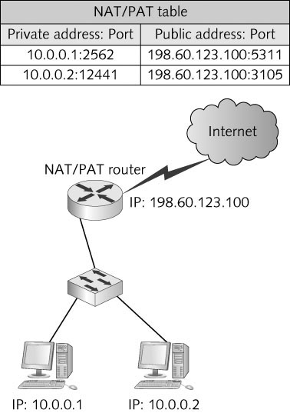
Network Address Translation
Copyright © 2012 Cengage Learning. All rights reserved.

Slide 44
Classless Interdomain Routing
CIDR is an addressing scheme that uses all available addresses more efficiently
When an address is assigned, the network and host IDs don’t always begin and end on octet boundaries according to the IP address class
  Instead the network address and host ID can be almost any number of bits
  Example: If your company requires only 30 host addresses, your ISP might give you the network address 192.203.187.0/27
    In a 32-bit IP address, the /27 means the first 27 bits of the IP address designate the network ID and the last 5 bits designate the host ID
Copyright © 2012 Cengage Learning. All rights reserved.

Slide 45
Subnet Masks
IP uses an address’s subnet mask to determine which part of the address identifies the network portion and which part identifies the host portion
Subnet masks are 32-bit numbers in dotted decimal format
  Default subnet mask for Class A is 255.0.0.0
  Default subnet mask for Class B is 255.255.0.0
  Default subnet mask for Class C is 255.255.255.0
Example: If a computer has the IP address 153.92.100.10 and the subnet mask is 255.255.0.0 then the network portion is 153.92 and the host portion is 100.10
Copyright © 2012 Cengage Learning. All rights reserved.

Slide 46
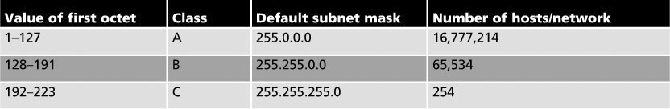
Subnet Masks
Example (continued): Using the same address of 153.91.100.10 but with a subnet mask of 255.255.255.0, the network portion is now 153.92.100 and the host portion is 10
By altering the subnet mask, the network ID has been altered
Copyright © 2012 Cengage Learning. All rights reserved.

Slide 47
How is the Subnet Mask Used?
Here's what happens when Computer1 has a packet to send to Computer2:
  Computer1 must first know its network address. It determines this by doing a logical AND operation between its IP address and subnet mask. A logical AND is an operation between two binary values. AND operations can have the following results:
  0 AND 0 = 0
1 AND 0 = 0
0 AND 1 = 0
1 AND 1 = 1
Copyright © 2012 Cengage Learning. All rights reserved.

Slide 48
Subnet Masks
Example (continued)
  The logical AND operation between Computer1’s IP address and subnet mask looks like this:
10101100.00010011.00101110.10111100 (binary for 172.19.44.211)
AND
11111111.11111111.11111111.00000000 (binary for 255.255.255.0)
____________________________
10101100.00010011.00101110.00000000 (binary for 172.19.44.0)
The resulting network address is 172.19.44.0.
  The next step is to determine whether Computer2’s address is on the same network by performing the same AND calculation between Computer 2’s IP address and Computer1’s subnet mask
  If Computer2 is on a different network, Computer1 knows that the packet must be sent to the router, which forwards it to the correct network
Copyright © 2012 Cengage Learning. All rights reserved.

Slide 49
Binary Arithmetic
Review how the decimal number system works
  0 through 9 are used to represent any possible number
  Each place in a decimal number can 10 possible values
  The ones place can be expressed as a number 0 through 9, multiplied by 10 raised to the 0 power or 10⁰ (any number raised to the 0 power equals 1)
  The decimal number 249 can be expressed as either of the following:
2 * 10² + 4 * 10¹ + 9 * 10⁰ = 249
2* 100 + 4 * 10 + 9 * 1 = 249
Copyright © 2012 Cengage Learning. All rights reserved.

Slide 50
Binary Arithmetic
With binary arithmetic, there are only 2 possible values (1 or 0)
For example, using the same method you used to solve the decimal example, you can express the binary number 101 as either of the following. The numbers in bold are the binary digits.
1 * 2² + 0 * 2¹ + 1 * 2⁰ = 5
1 * 4 + 0 * 2 + 1 * 1 = 5
Copyright © 2012 Cengage Learning. All rights reserved.

Slide 51
Binary Arithmetic
128 | 64 | 32 | 16 | 8 | 4 | 2 | 1
2⁷ | 2⁶ | 2⁵ | 2⁴ | 2³ | 2² | 2¹ | 2⁰
0 | 1 | 1 | 1 | 1 | 1 | 0 | 1
Decimal to binary conversion table = Convert 125 to binary:
125 is less than 128, so you place a 0 in the column under the 128. The test number remains 125.
125 is greater than 64, so you place a 1 in the column under the 64 and subtract 64 from 125, leaving your new test number as 61.
61 is greater than 32, so you place a 1 in the column under the 32 and subtract 32 from 61, leaving your new test number as 29.
29 is greater than 16, so you place a 1 in the column under the 16 and subtract 16 from 29, leaving your new test number as 13.
13 is greater than 8, so you place a 1 in the column under the 8 and subtract 8 from 13, leaving your new test number as 5.
5 is greater than 4, so you place a 1 in the column under the 4 and subtract 4 from 5, leaving your new test number as 1.
1 is less than 2, so you place a 0 in the column under the 2.
1 is equal to 1, so you place a 1 in the column under the 1 and subtract 1 from 1, leaving your new test number as 0. When your test number is 0, you’re done.
Copyright © 2012 Cengage Learning. All rights reserved.

Slide 52
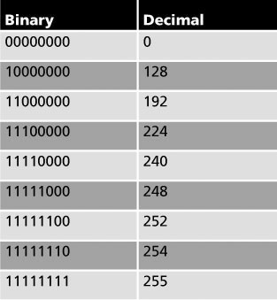
Binary Arithmetic
Many of the numbers you work with when subnetting have patterns
The subnet mask always consists of a series of zero or more 1s, followed by a series of zero or more 0s, as the table above shows
Copyright © 2012 Cengage Learning. All rights reserved.

Slide 53
Calculating a Subnet Mask
There are usually two approaches to subnetting, and they depend on the answer to these questions:
  Am I subnetting to provide a network with a certain number of host addresses?
  Or am I subnetting to provide a network with a certain number of logical subnets?
  If you're working for an ISP, the answer is usually yes to the first question, and if you’re a network administrator for a corporate network, the answer is more likely to be yes to the second question.
  Sometimes the answer is a combination of both.
Copyright © 2012 Cengage Learning. All rights reserved.

Slide 54
Calculating a Subnet Mask
Subnetting Example: You have a large internetwork and need to break an IP address space into several subnets. Follow this process:
First, decide how many subnets you need. Each router interface connection indicates a required subnet.
Decide how many bits you need to meet or exceed the number of required subnets.
Use the formula 2^{n}, with n representing the number of bits you must reallocate from the host ID to the network ID.
The number of subnets you create is always a power of 2, so if you need 20 subnets, you must reallocate 5 bits (2⁵ = 32) because reallocating 4 bits gives you only 24 or 16 subnets.
Copyright © 2012 Cengage Learning. All rights reserved.

Slide 55
Calculating a Subnet Mask
Subnetting example (continued)
  Reallocate bits from the host ID, starting from the most significant host bit (that is, from the left side of the host ID).
  You must also ensure that you have enough host bits available to assign to computers on each subnet. To determine the number of host addresses available, use the formula 2^{n} - 2, with n representing the number of host (0) bits in the subnet mask.
Copyright © 2012 Cengage Learning. All rights reserved.

Slide 56
Supernetting
Sometimes necessary to solve certain network configuration problems and to make routing tables more streamlined
Sometimes referred to as “route aggregation” or “route summarization”
Supernetting reallocates bits from the network portion of an IP address to the host portion
  Making two or more smaller subnets a larger supernet
Copyright © 2012 Cengage Learning. All rights reserved.

Slide 57
Introduction to Internet Protocol Version 6
IPv6 solves some problems in IPv4:
  Limits of the 32-bit address space
  Lack of built-in security
  Complicated setup
  Lack of built-in quality of service (QoS)
An IPv6 address is 128 bits instead of 32 bits in IPv4
IP Security (IPSec) protocol is incorporated into IPv6
IPv6 is autoconfiguring (no IP address to assign and no subnet mask to determine)
Copyright © 2012 Cengage Learning. All rights reserved.

Slide 58
IPv6 Addresses
Specified in hexadecimal format in 16-bit sections separated by a colon
Example: 2001:1b20:302:442a:110:2fea:ac4:2b
An addressing hierarchy of three parts is used: a public topology, a site topology, and an interface identifier.
  The first three 16-bit sections (totaling 48 bits) represent the public topology, which could be an Internet backbone service provider
  The next 16 bits represent the site topology, such as a business or a local ISP
  The last 64 bits (four 16-bit sections) represent the interface identifier, which is derived from the MAC address on the host’s NIC. The interface identifier is the unique host address.
Copyright © 2012 Cengage Learning. All rights reserved.

Slide 59
Chapter Summary
TCP/IP is the principal protocol used in computer networks
The Network Access layer is composed of network technologies such as Ethernet and Token Ring
The Internetwork layer is where most network configuration occurs and is composed of IP, ICMP, and ARP
The Transport layer provides reliability and works with segments
The Application layer consists of protocols such as HTTP and DNS
Copyright © 2012 Cengage Learning. All rights reserved.

Slide 60
Chapter Summary
IP addresses are divided into a network ID and host ID
CIDR largely replaces classfull addressing and uses a prefix number or subnet mask to determine the network and host IDs of an IP address
Subnetting allows an administrator to break a large network into two or more smaller networks that require a router to communicate between them
IPv6 will eventually replace IPv4 because of its larger 128-bit address space and built-in security and QoS features
Copyright © 2012 Cengage Learning. All rights reserved.

